Slide 1

Predicting Energy Consumption Cost in Residential Units
Capstone 2
Javier Nuno
What is the estimated cost of energy in a residential unit, given the attributes available on any listing services website?

Slide 2
Why does it matter?
Capstone 2
Javier Nuno
Most listing services and realtors do not have the information or tools to predict energy bill costs, and it can weigh heavily on the buying decision.
Energy consumption costs can be useful to calculate future investments in systems update or rehabilitation projects.

Slide 3
Objective
Capstone 2
Javier Nuno
Provide Homebuyers, homeowners, and retail rental property investors a powerful tool to estimate the house yearly energy bill.
Just by providing a few parameters shown in a typical listing services website (RedFin, Realtor.com, Zillow)

Slide 4
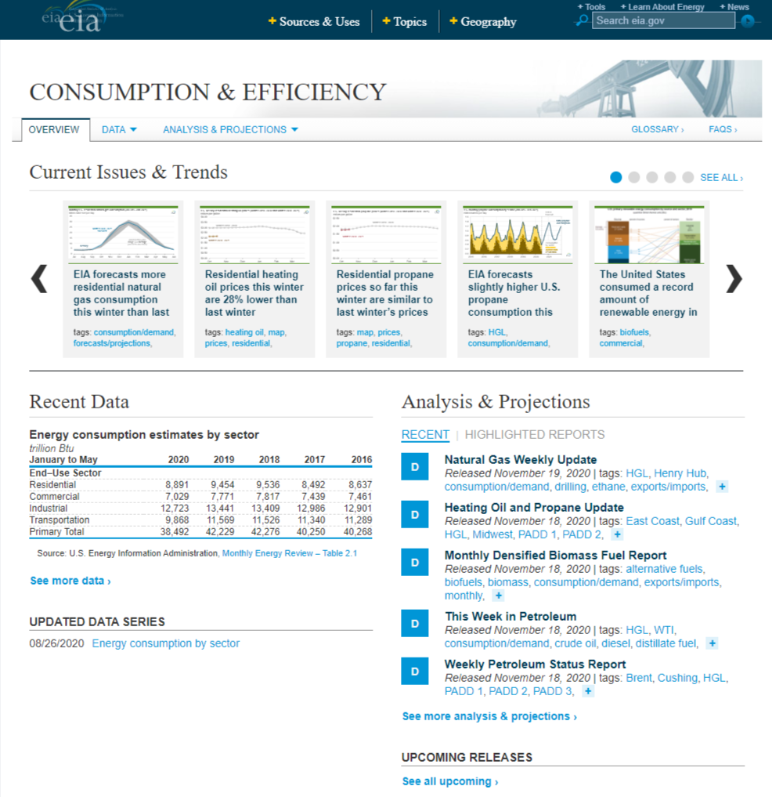
The dataset
Capstone 2
Javier Nuno
2015 Residential Energy Consumption Survey data (RECS)
5,686 observations and 759 variables
17 explanatory variables selected
4 response variables selected

Slide 5
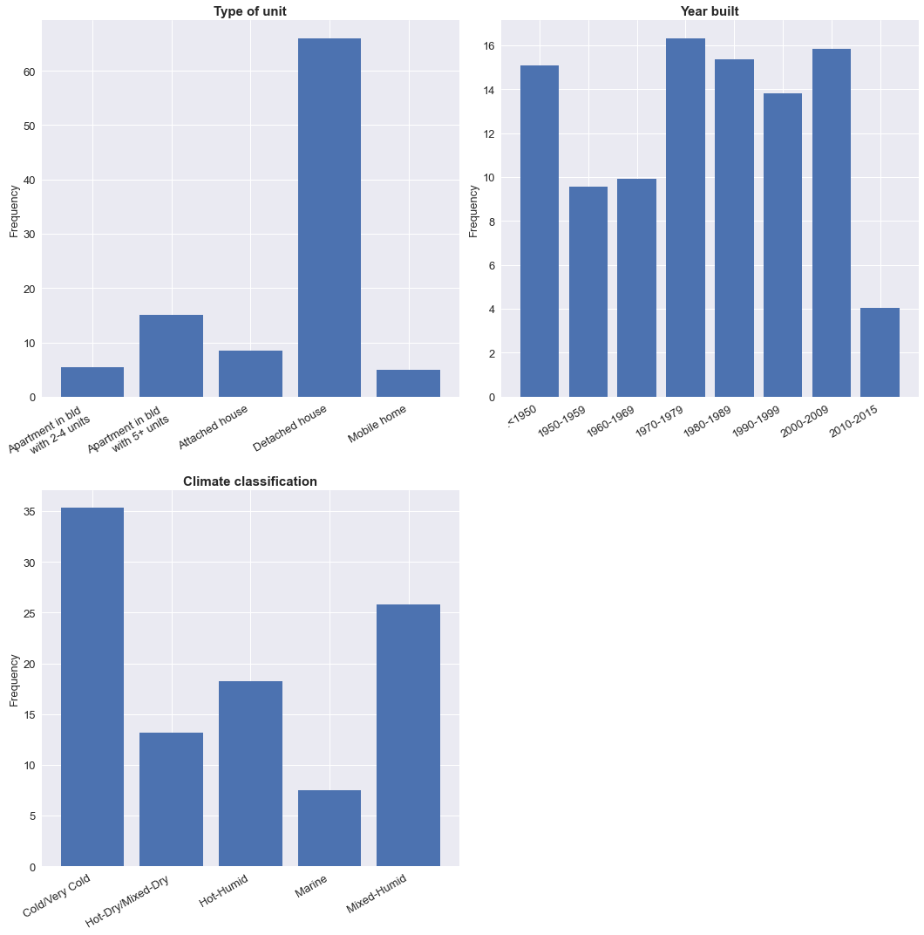
Data Analysis (I)
Capstone 2
Javier Nuno
Categorical variable distributions

Slide 6
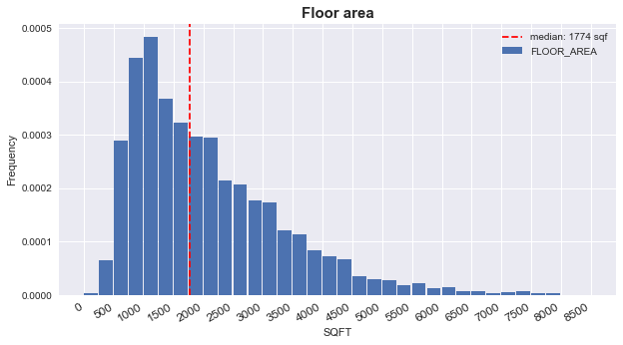
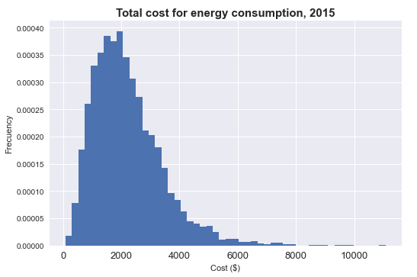
Data Analysis (II)
Capstone 2
Javier Nuno
Numerical variable distributions

Slide 7
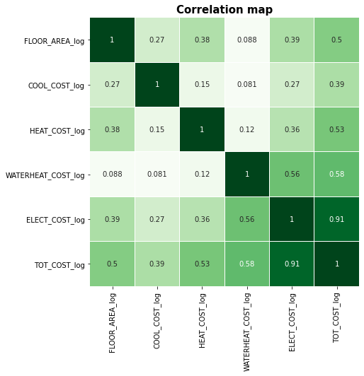
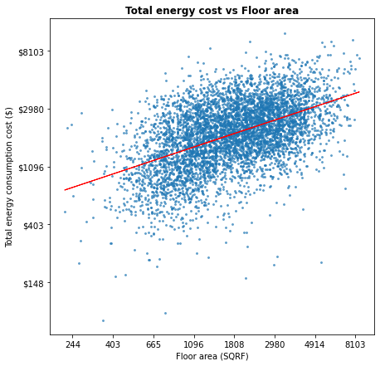
Data Analysis (III)
Capstone 2
Javier Nuno

Slide 8
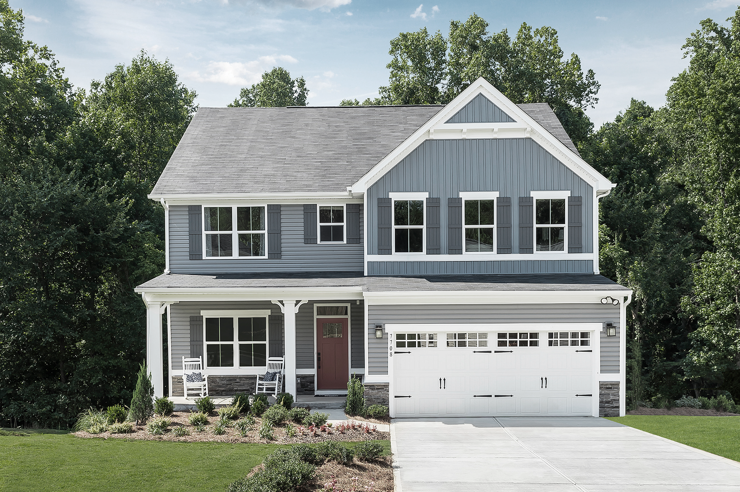
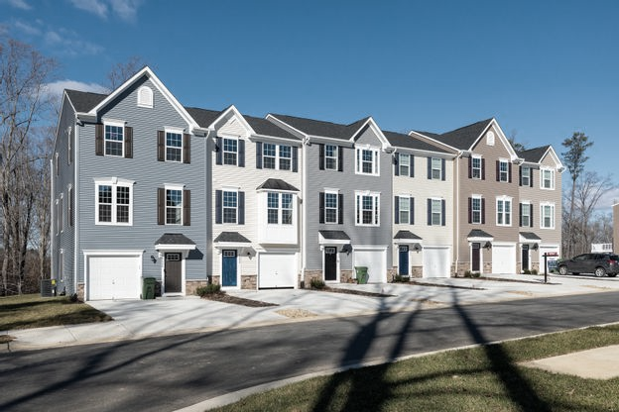
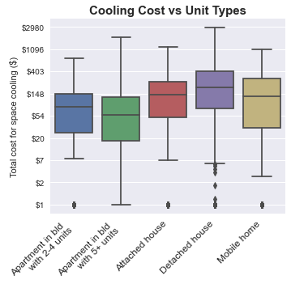
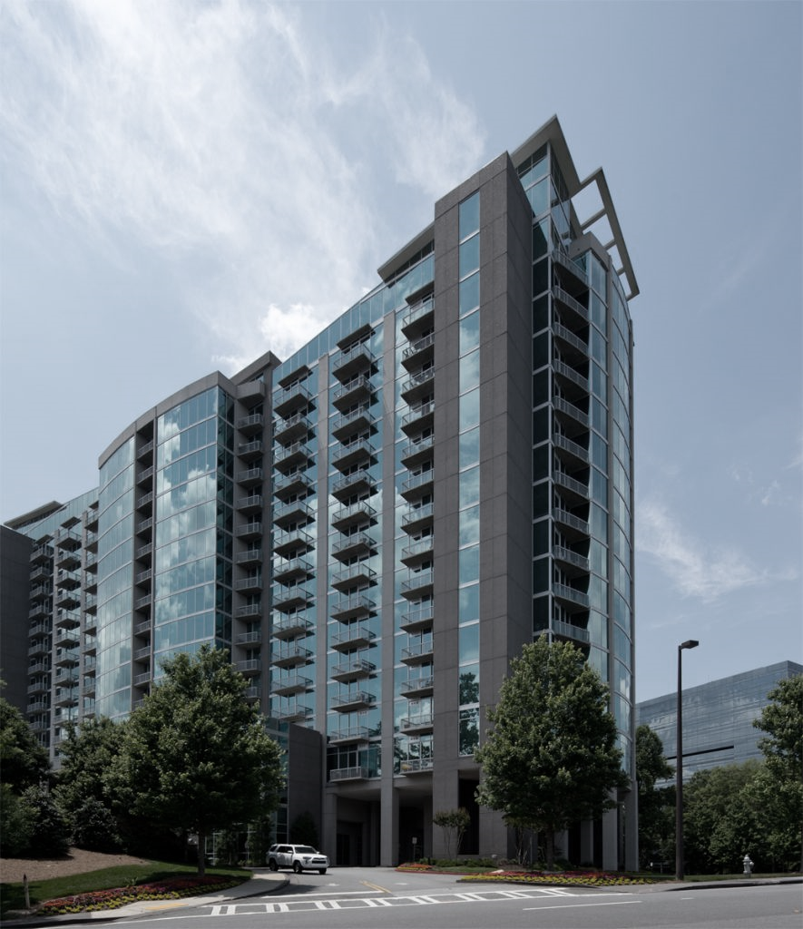
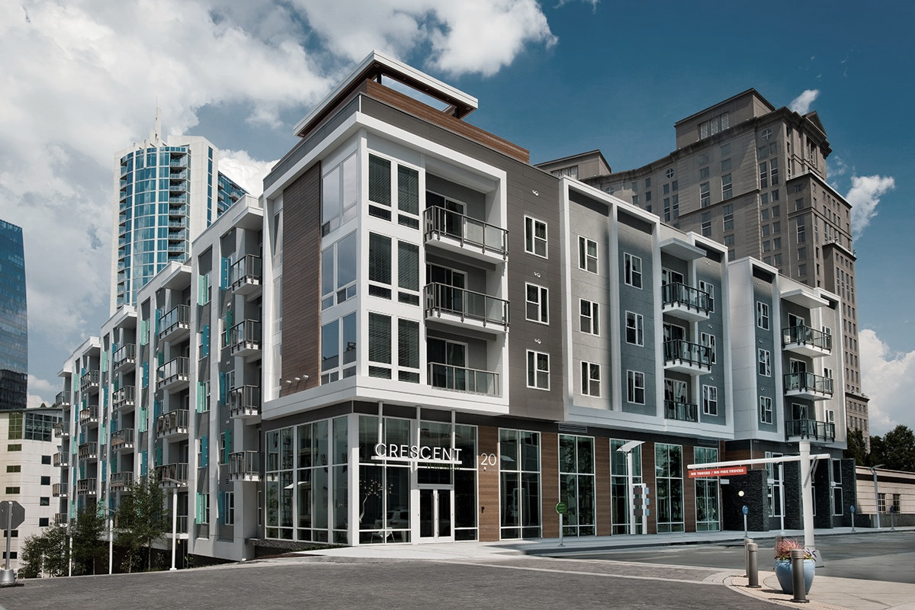
Data Analysis (IV)
Capstone 2
Javier Nuno
Single family home (Detached)
Single family home (Attached)
High-rise condo
Low-rise condo

Slide 9
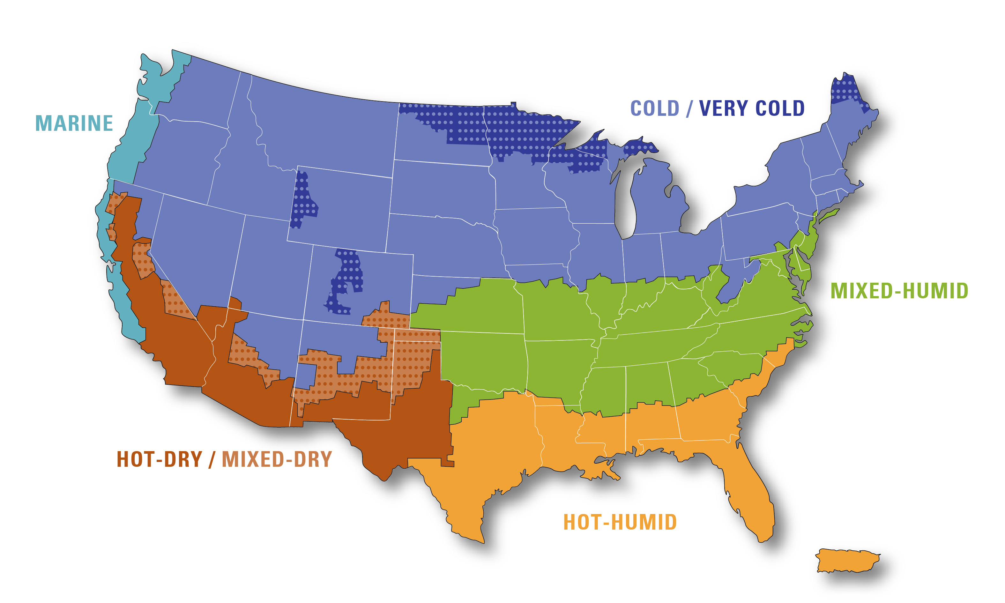
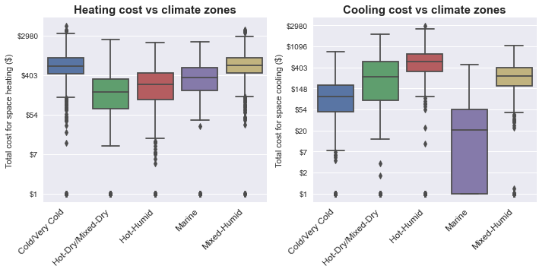
Data Analysis (V)
Capstone 2
Javier Nuno
Climate regions

Slide 10
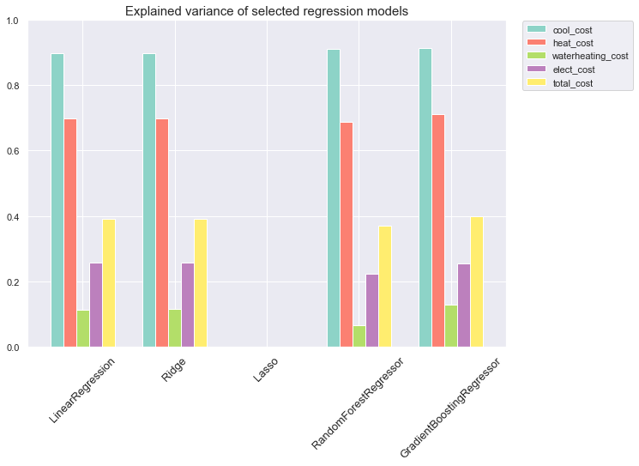
Model testing
Capstone 2
Javier Nuno
Out-of-box algorithms test results
Linear Regression (OLS)
Linear Regression with L2 regularization
Linear Regression with L1 regularization
Random Forest Regressor
Gradient Boosting Regressor

Slide 11
Model performance scores
Capstone 2
Javier Nuno
Features | Explained variance | MAE | Min | Median | Max
cooling cost | 0.915 | 99.68 | 0.00 | 146.60 | 2,860.01
heating cost | 0.708 | 247.07 | 0.00 | 400.84 | 4,766.66
water heating cost | 0.144 | 131.84 | 0.00 | 236.44 | 2,566.61
other electricity cost | 0.253 | 434.26 | 15.43 | 1,021.74 | 7,310.58
total electricity cost | 0.396 | 719.65 | 76.40 | 1,997.59 | 11,078.48

Slide 12
Conclusions
Capstone 2
Javier Nuno
None of the explanatory variables have a strong correlation with the target variables
However, a combination of them can explain over 90% variance in case of Cooling Costs and 70% in case of Heating Costs. Error may be too large to provide useful information for low consumption units.
The model has a weak prediction power with Other Electricity Costs and Total Consumption Costs but still can provide an upper consumption limit with 80% probability.
Variables in the dataset cannot explain Water Heating Costs variance, which depends on other socioeconomic, behavioral and heater fuel type data.

